Slide 1

What is Under the Hood of a Modern Computer?
Mr Butler

Slide 2
Traditionally we think of computers as the large desktop machines that many of us regularly use at home and at school.
However, in recent years’ computers have become faster and smaller

Slide 3

Raspberry Pi
One small computer is the raspberry pi, the credit-card sized computer that you can plug into the TV and a keyboard. Can you locate the processor, the memory, the storage and the input and output?

Slide 4
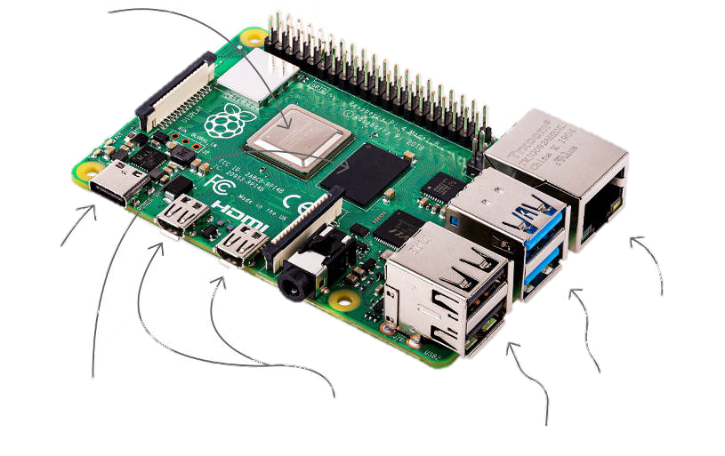

Label the Following diagram with the component parts:
A
Processor | A
USB-C Power Supply | B
USB 2 | E
USB 3 | F
Micro HDMI Ports | D
Ethernet Port | G
RAM | C
?
?
?
?
B
G
?
F
?
C
D
E
?
Notes:
Teacher Comment: Click on the buttons to right of components to display the answers

Slide 5

Key Terms
Input Devices: An input device enables the user to ‘input’ data into a computer.
Memory: This is where a computer keeps the data that has been input, as well as software applications and the results of any processing it has carried out, for the short term. This memory is lost when the computer is turned off.
Storage Device: This is where a computer stores files that have been created, as well as software that has been installed, for the longer term.
Processor: The part of a computer that processed data according to the instructions it has been given. It provides the user with information.
Output Device: An output device enables the user to receive information from a computer.

Slide 6
Homework: Spelling Test
Learn the following Key terms for a spelling test next lesson:
Folder Password Safety Expectations
Backup Blind Carbon Copy Memory Hard Disk Drive
Graphics Card Input Output Processor
Hardware Software Motherboard Attachment
Employee Raspberry Pi Eye Strain
Repetitive Strain Injury

Slide 7
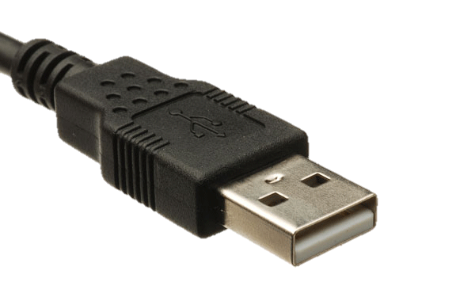
U
S
B
UNIVERSAL
SERIAL
BUS
used to connect devices, transfer data, and supply power between computers and peripherals like keyboards, mice, printers

Slide 8

Understanding what makes your computer games console work
https://www.bbc.co.uk/programmes/p07t308p
Notes:
https://www.bbc.co.uk/programmes/p07t308p

Slide 9

Algorithm
a sequence of instructions or a set of rules that are followed to complete a task or solve a problem. This task can be anything, so long as you can give clear, short and specific instructions for it.

Slide 10
An Example of an Algorithm
1: Come in and sit down quietly
2: Log on to your computer
3: Use a browser (internet explorer or google chrome) to navigate to google search engine
4: Research or find out what the term ‘algorithm’ means (You may need to visit a few sites)
5: When you have found out enough about the term ‘algorithm’ to explain its meaning to another student, turn off your monitor (screen) when you have finished.

Slide 11
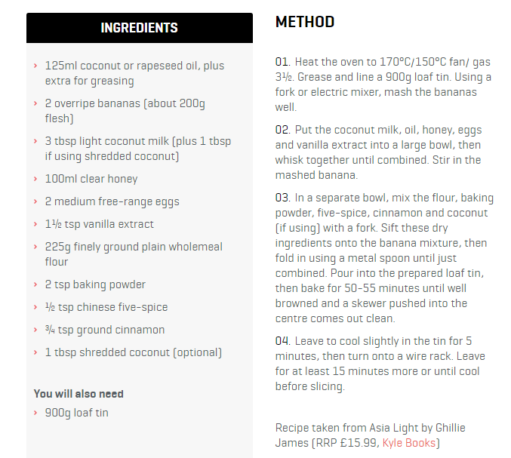

What other examples are there?
Recipe for baking a cake

Slide 12

What other examples are there?
Directions to a specific place
1: Turn right after the bank
2: Walk straight until you get to the traffic lights
3: Turn right
4: Walk straight until you get to the traffic light
5: Turn left
6: Walk straight
7: Follow the road round to the right (passing McDonalds on your left).

Slide 13
Computers are very good at carrying out sequence of precisely defined instructions.
Algorithms can be used as a simply tool to help write a computer programs (which are simply instructions telling the computer what to do.)
You may want a computer to calculate the answer to 25 divided by 5. Or tell you whether a certain number is prime or not.
To more complex systems algorithms can be used to study the pages that you like on Facebook and determine which ads would be best to show you.
Once you come up with a particular algorithm then you can implement it in any programming language of your choice.

Slide 14
Computers & Algorithms
Computer’s don’t actually understand algorithms as they use a different language.
Algorithms need to be translated into code which the computer can understand and can follow to complete a task.
Code is written in a programming language – just like speaking though there are many different programming languages.
Some that you may come across are Scratch, Python and C#. Each of these languages are better suited to different things. Game developers use several different programming languages – sometimes even in the same game!

Slide 15
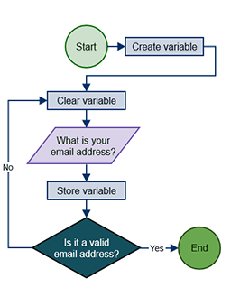
How computers carry out program instructions based on algorithms.

Slide 16
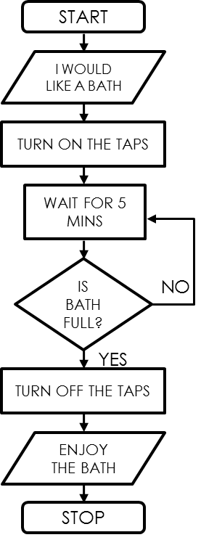
LEARNING TASK - Flowcharts
What is a flowchart?
A flowchart is made up of symbols and arrows.
A flowchart can be used to help design a sequence, which can control an event.
Actions can be ordered, reordered or removed if no longer necessary.
What is this flowchart about?
What are the different shapes?
What is unique about one of them?

Slide 17
LEARNING TASK - Flowchart Symbols
The four main symbols
START / STOP
Start or stop a program
These are the main flowchart symbols you will need to know.
INPUT or OUTPUT
Receive data or give a signal
PROCESS/DELAY
Give an instruction; often involves a delay
DECISION
NO
Ask a question with a YES or NO answer
YES

Slide 18
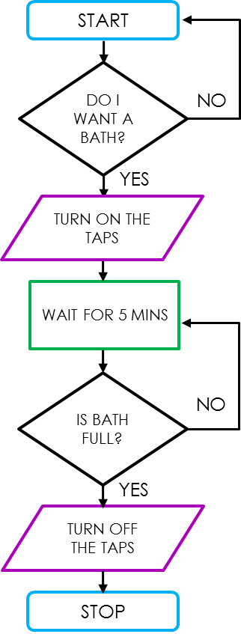
LEARNING TASK - Flowchart Symbols
The four main symbols
START / STOP
Start or stop a program
INPUT or OUTPUT
Receive data or give a signal
PROCESS/DELAY
Give an instruction; often involves a delay
DECISION
NO
Ask a question with a YES or NO answer
YES

Slide 19
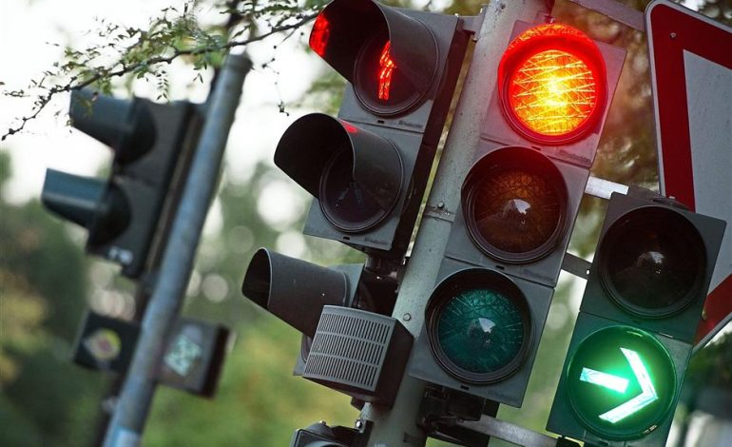
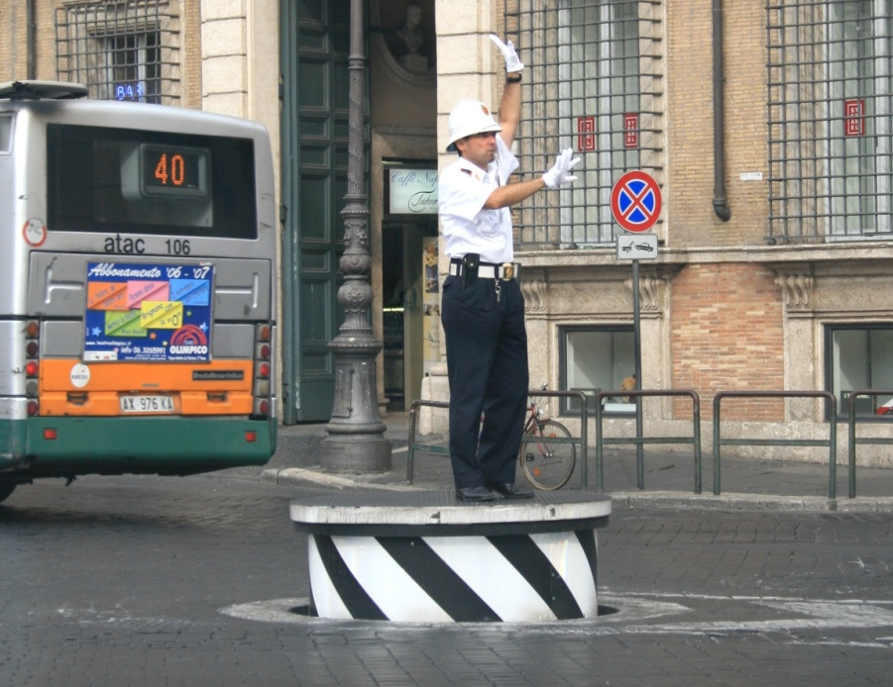
CLASS DISCUSSION - Which is better?
Human vs. Computer
Which is better? Discuss…
Why do you think it is better?
Explain your reasons…
vs.

Slide 20
LEARNING TASK - Computer Control
Advantages
COMPUTERS:
do not need breaks.
do not take sick days or holidays.
can repeat actions in an identical way indefinitely.
can work in environments that are dangerous for people.
don't need to be paid.
can process data from sensors very quickly.
can manage hundreds/thousands of inputs at the same time.
can make reliable and accurate decisions.

Slide 21
LEARNING TASK - Computer Control
Disadvantages
COMPUTERS:
are only as good as their programming, which may contain errors.
that are faced with conditions not covered in their programming will not know what to do.
which are underpowered might take too long to do something in a time-critical situation.
rely on power; if there is a power cut the program will not work.
may cost a lot of money to purchase, maintain and develop.

Slide 22
How Computers Work
Computers understand a very simple language – just 0 and 1s.
  That’s a lot less than the letters we use in our alphabet!
This language is known as binary.
Computers read millions of these 1s and 0s every second!
Humans program these computers, often using variables. Follow the instructions on the next slide to see what this means!

Slide 23
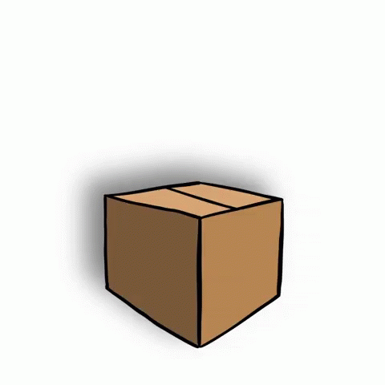
What’s a variable?
A variable is a location in memory in which you can temporarily store text or numbers
It is used like an empty box or the memory function on a calculator
You can choose a name for the box (the “variable name”) and change its contents in your program.
X is the variable
X = 50
X = X + 5

Slide 24
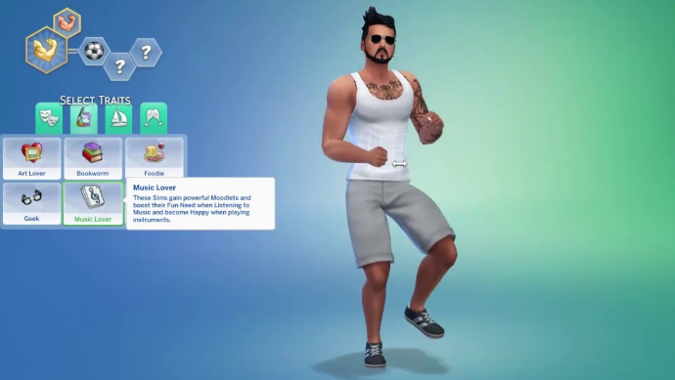
Variables
Hair Colour (Black/Blue/Blonde)
Hair style (Long/Short/Combed/Frizzy)
Piercings (One/Both/Style)
Glasses (Yes/No).
Tattoos (What/Where/Colour)
Choice of Shorts (Long/Colours)
So here is a ‘human’ object. The question is what VARIABLES are there for this human? What makes them different from one another?
Choice of Top (Tank/T Shirt/Shirt)
Choice of Footwear (Trainers/Boots/Shoes)
Name? Age? Interests? There are literally thousands of variables!

Slide 25
A simple Program
Well, We could have a program that works as a calculator!
START
SET answer AS 2 x 4
PRINT ANSWER
END

Slide 26
So, how does this help?
Well, We could add variables in order to make this more usable
START
INPUT number1
INPUT number2
SET answer AS number1 x number2
PRINT ANSWER
END
It MAY be slightly longer, but think of how much more usable this is!

Slide 27
Variables
Variables make our programs a lot more reusable. Simple things like displaying your name at the top of the screen, or having a score appear.
We can store text, numbers and even ‘true’ or ‘false’ values
Variables allow us to store, change and access these values as the program runs.

Slide 28
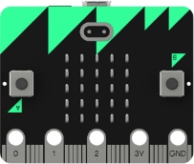
What is the BBC Micro:Bit?
Pocket Sized codable computer
25 red LEDs that can light up, flash messages, create games and invent digital stories
Two programable buttons.
  Can use it as a games controller
  Can even be used to pause or skip songs on a playlist!
Has a motion detector (accelerometer) that can detect movement
Built in compass (magnetometer)
Bluetooth smart technology – can connect to other Microbits or devices

Slide 29
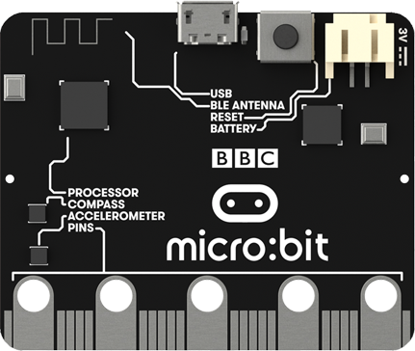
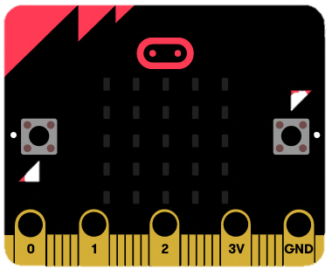
The Components
Programmable Buttons
25 LEDs
Compass
Bluetooth
Accelerometer

Slide 30

How does the LED light array work?
The LEDs are arranged in a 5x5 grid
Much like coordinates, these can be referenced to X and Y.
Unlike coordinates, we reference them like so:
0
1
2
3
4
0
1
This LED would be referenced as (3,1)
2
3
4

Slide 31

Programming Buttons
With 2 programable buttons, we can use these as inputs for our Microcontroller.
Let’s make a short program:

Slide 32


Looping
Q: What does the word ‘Loop’ mean in programming?
Ans: To repeat.
For example, we could loop 2 or 3 times. Or 5. Or 100. Or even forever

